Slide 1
Review-based Popularity Analysis of the Online Fashion Industry
presented by:
Antony Paulson Chazoor | Komal Jaiswal | Muhtasin Rahman | Shweta Patil

Slide 2
Introduction
Fast fashion industry is a profitable arena
Driven by word of mouth, perceived fashion value drives sales
Reviews extremely impactful, especially online where there are no trials
Future-centric thinking needed to follow customer preference and fashion trends
Popularity among consumers paramount for continued business success
Goal: Predict popularity based on key adjectives in reviews

Slide 3
RESEARCH QUESTIONS
What are the most popular items?
What are the most frequent words used by reviewers?
Do popular products have characteristic keywords?
Possible to predict popularity based on review text?

Slide 4
RESEARCH IMPLICATIONS
Popular products dictate future stock and promotions
Automated system to detect popular products
Unpopular products changed or advertised differently
Detect trends to adjust marketing strategy and research
Curb customer criticism and engender customer engagement
Decrease return rate and avoid restocking fees

Slide 5
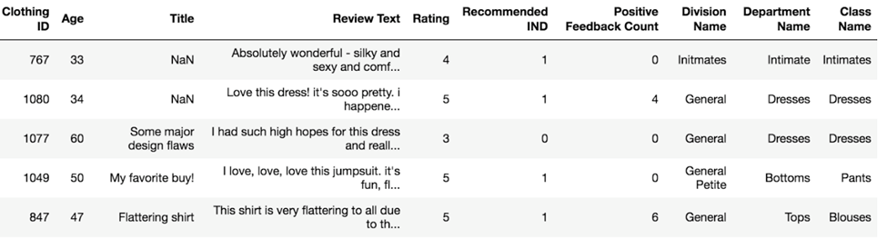
DATA DESCRIPTION
Kaggle.com, a data repository website
23486 rows, 10 feature variables for women's clothing
Main attributes:
-Clothing ID
-Review Text

Slide 6
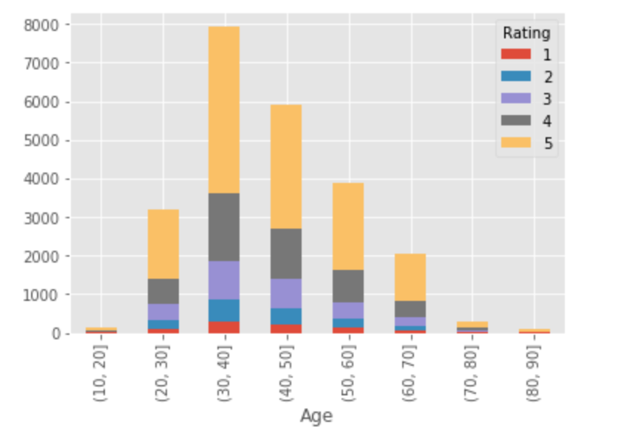
EXPLORATORY DATA ANALYSIS
Age group-Ratings Breakdown
Age group 30-40 gave best ratings and review the most

Slide 7
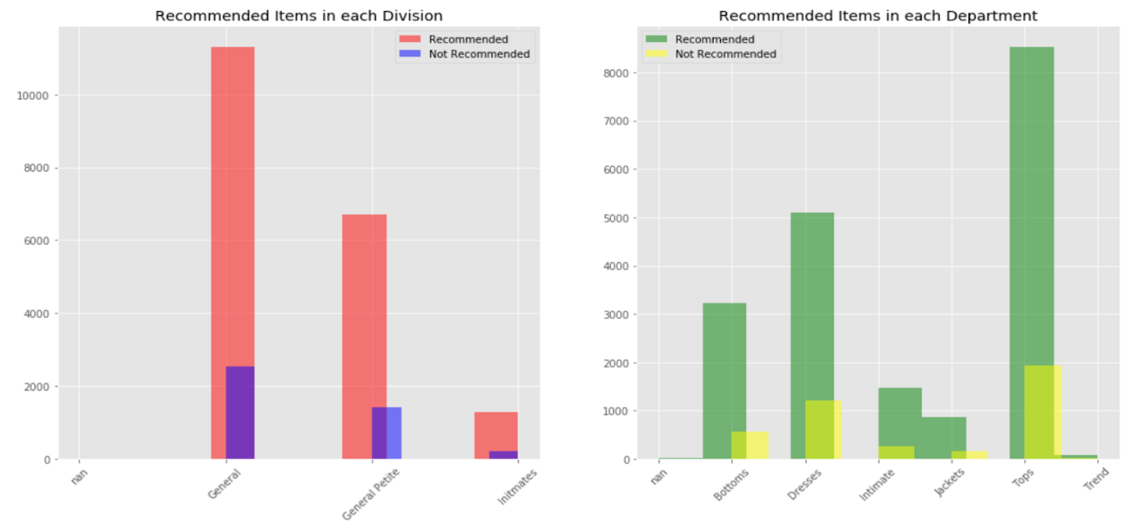
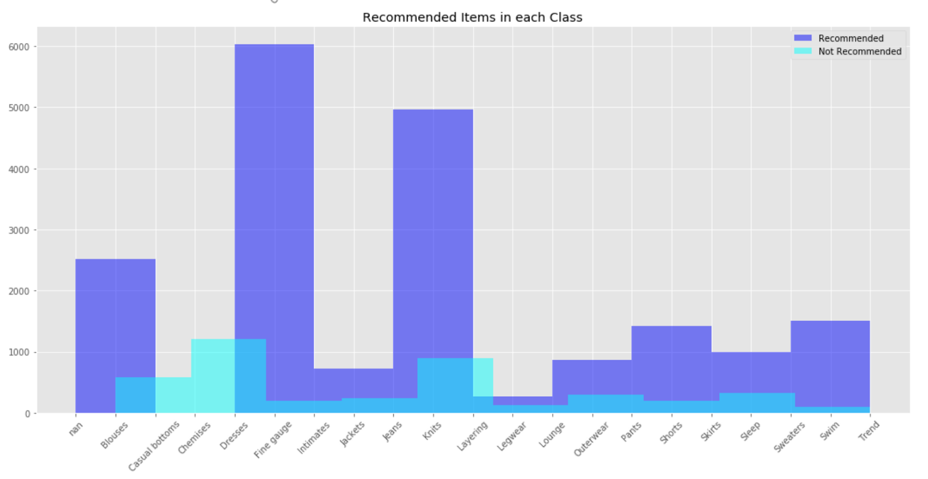
The most recommended items are from General Division
The most recommended items are from the Tops, Dresses and Bottoms department
The most recommended items are from Dresses, Fine Gauge and Intimates Class

Slide 8
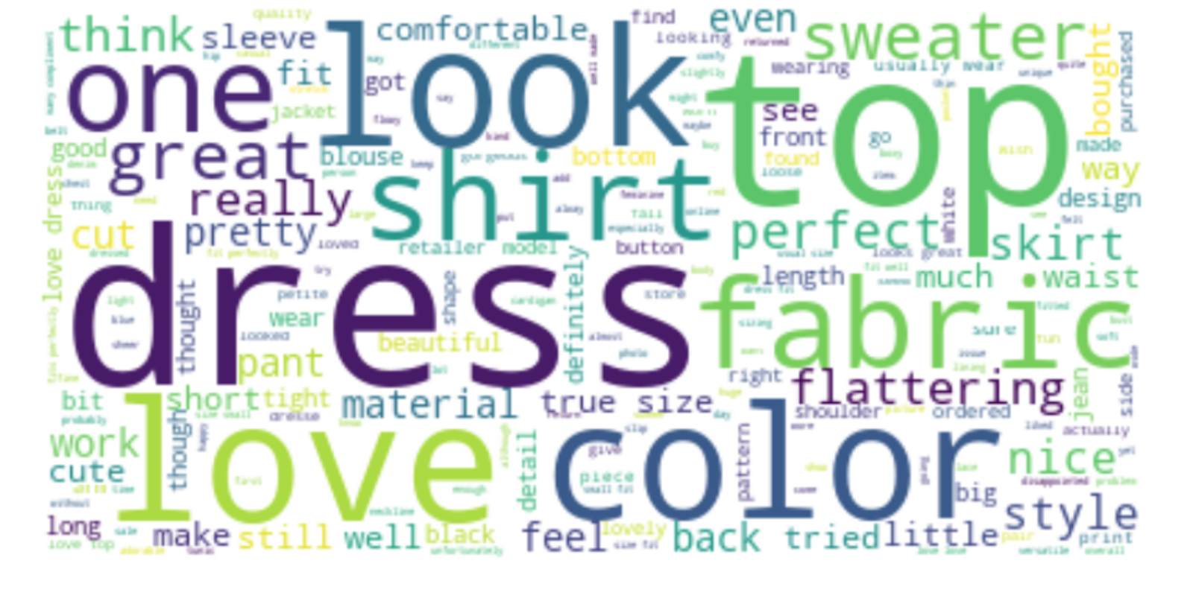
Reviews have approx. 200 or more words in length
Reviews of ratings 3 and 4 have greater length
482,899 words in reviews corpus

Slide 9
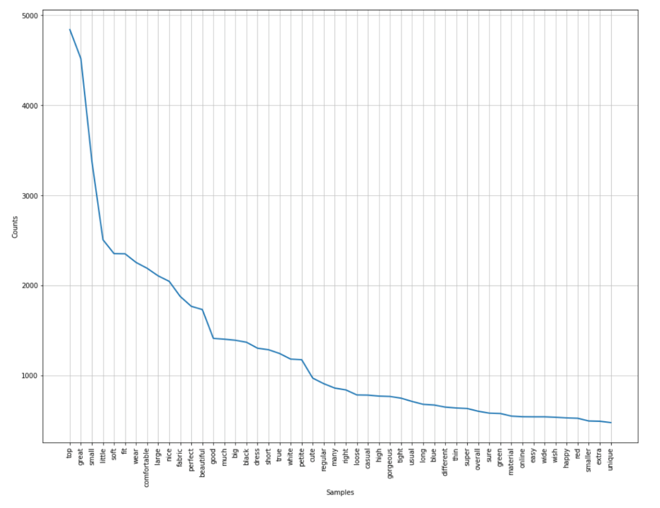
Top 50 adjectives picked with at least 500 repetitions
‘JJ’, ‘JJR’ and ‘JJS’ part of speech tagging
Top adjectives - Top, Great, Small, Little

Slide 10
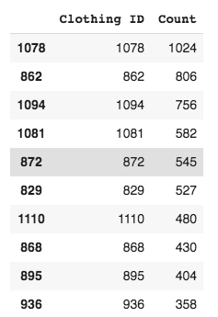
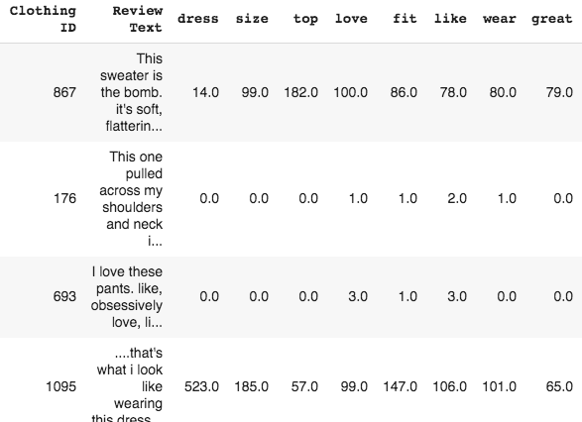
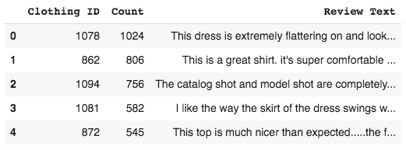
methodology
Dataset
partitioned to validation and training to approx.
(70:30)
Select popular
apparel:
Highest number
of reviews
Part of Speech tagging, removing stop-words, punctuations to extract adjectives
Collate all reviews of these popular items into one
50 most frequent adjectives used for prediction

Slide 11
DATA MANIPULATION
50 new columns with individual adjective frequency
"Popular" column based on number of reviews
Columns: clothing ID, reviews, adjectives, popular

Slide 12
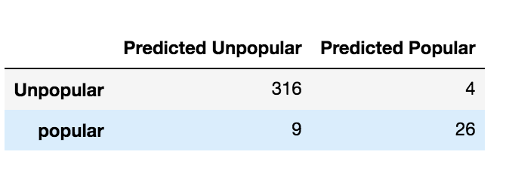
Logistic Regression
Training on 824 records, validating on 384
96.3% accuracy
Only 13 items misclassified
Only 9 popular items predicted as unpopular
Only 4 unpopular items predicted as popular

Slide 13
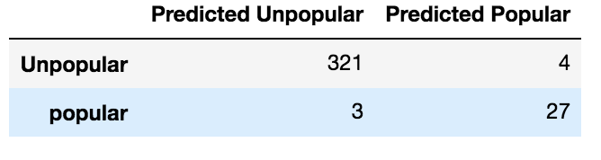
Decision Tree
Easy to interpret
98% accuracy
Only 7 items misclassified
Only 3 popular items predicted as unpopular
Only 4 unpopular items predicted as popular

Slide 14
conclusion
30-40 year olds leave most reviews, followed by 40-50 and 50-60 age groups
Tops are most recommended
Among those Dresses, Fine Gauge and Intimates most recommended
Representative words present in reviews of popular products
Models utilizing adjectives successful in predicting clothing popularity
Decision Tree best model with 98%

Slide 15
Further improvements
The Model learned to predict unpopular items better
Balance by collecting more data on popular items and training the model to predict popular items
Features in the original dataset can be used to make a holistic prediction model

Slide 16

THANK YOU! Questions?

